Slide 1
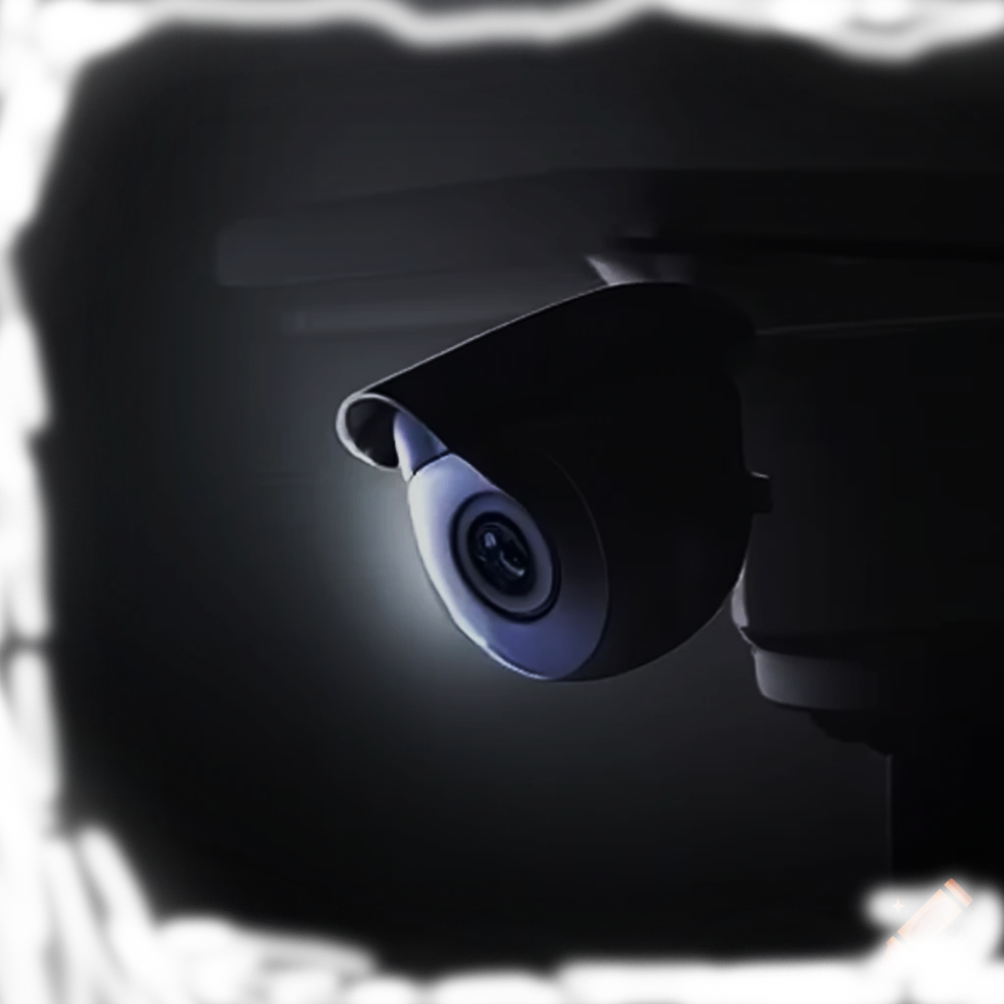
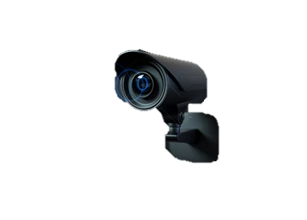
Intelligent Indoor OR Outdoor Surveillance
Camera with AI Detection
and Programmable Relay Control
Group 01: Tech Titans
Notes:
模板来自于： 第一PPT https://www.1ppt.com/

Slide 2
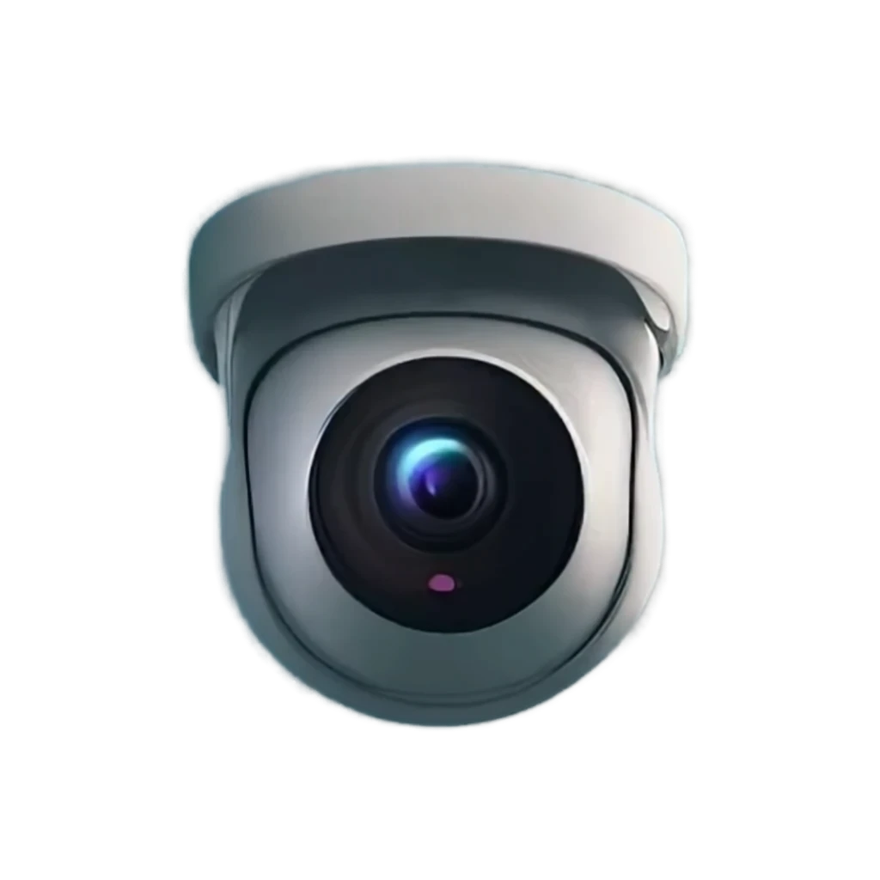
Slide 02
Group members
Name | Index_No | Reg_NO
E.M.S.M. Edirisooriya | 1297 | ITT/2020/021
D.H.D. Prabhasha | 1348 | ITT/2020/078
H.L.I.N. Liyanaarachchi | 1390 | ITT/2020/128
P.W.D.I.M. Rodrigo | 1357 | ITT/2020/091
B.M.K.L Bandaranayake | 1383 | ITT/2020/121
K.R.N. Perera | 1343 | ITT/2020/072
A. Sanjayan | 1363 | ITT/2020/097

Slide 3

Slide 03
Introduction
Introduction
Home security is becoming increasingly important as technology advances. Many older security camera systems lack the flexibility and advanced features needed to handle today's security challenges effectively. This project aims to
address these issues by creating an intelligent indoor or outdoor surveillance camera with AI detection and programmable relay control.

Slide 4

行业PPT模板http://www.1ppt.com/hangye/
Slide 04
Lack of Physical Relay Integration
Complex Installation.
01
02
Extensive Hardware Requirements
Problem Statement
03
High Cost
04
Storage Limitations
05
Limited Accessibility
06
CLICK HERE TO ADD A TITLE
Notes:
模板来自于： 第一PPT https://www.1ppt.com/

Slide 5
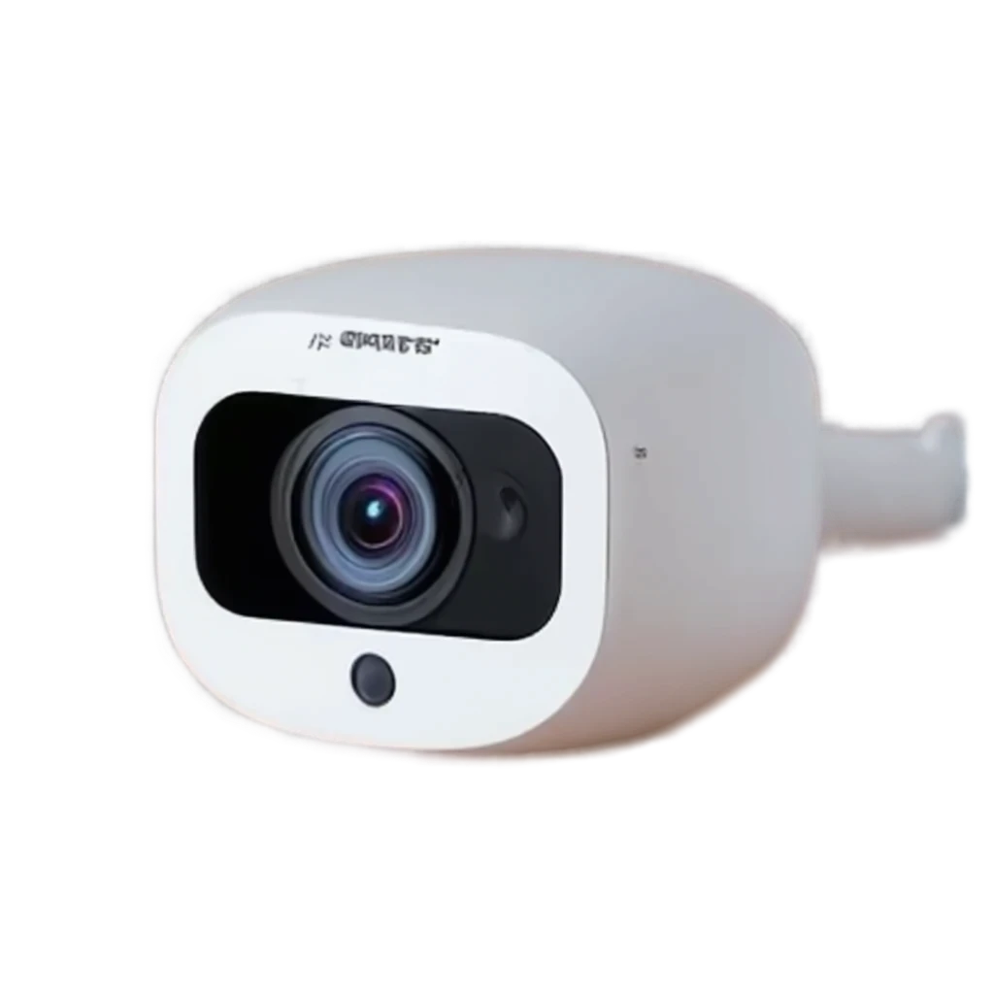

Aim and Objectives
Slide 05
Aim and Objectives
Aim : Develop a unique ESP32-CAM WIFI IP camera surveillance system with AI-powered object detection using YOLOv8.
Objectives :
Implement Video Recording Functionality
Enable Cloud-Based Live Streaming
04
Implement Remote Physical Relay Control
Integrate AI-Powered Object Detection
03
05
02
Develop Flutter Mobile Application
Developing the ESP32-CAM WIFI IP Camera
06
04
01
Enhance Security Alerts and Notifications
07

Slide 6
Related works
Slide 06
Related works
Hawk-Eye : An AI-Powered Threat Detector for Intelligent Surveillance Cameras
[L. Park, “Hawk-Eye: An AI-Powered Threat Detector for Intelligent Surveillance Cameras,” IEEE Access, vol. 9, pp. 63283-63293, Apr. 2021, doi: 10.1109/ACCESS.2021.3074319.]
Real-time super resolution algorithm for security cameras
[L. Park, “Improving Contrast and Resolution of Low-Contrast Infrared Images and Video,” in Proceedings of the 2015 12th International Joint Conference on e-Business and Telecommunications (ICETE), Colmar, France, 20-22 July 2015, pp. 1-49, doi: 10.1109/ICECCME52200.2015.9591068]
Home security system using internet of things
[A. Anitha, “Home Security System Using Internet of Things,” IOP Conference Series: Materials Science and Engineering, vol. 263, no. 4, p. 042026, 2017. doi: 10.1088/1757-899X/263/4/0420263.]
A Smart IoT Security System for Smart-Home Using
Motion Detection and Facial Recognition
[A. Anitha, “Smart IoT Security System for the Smart-Home,” in Proceedings of the 2020 IEEE 44th Annual Computers, Software, and Applications Conference (COMPSAC), Madrid, Spain, 13-17 July 2020, pp. 1-49, doi: 10.1109/COMPSAC48688.2020.0-132.]

Slide 7


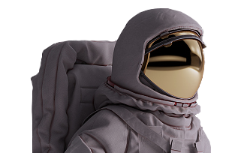
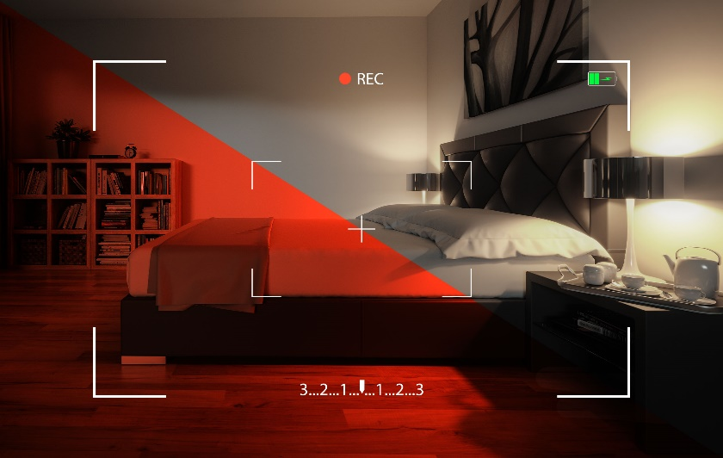
Methodology
Slide 07
Methodology
Local Recording
Toggle System
Global Cloud Access
AI-Powered Object Detection with YOLOv8
Smart Relay Control
This Monitoring camera and Programmable Relay Control leverages a combination of hardware components, custom software, and cloud-based services for real-time video streaming and AI object detection.
Intelligent Security Notifications
1. Restricted Area Intrusion
2. Pet Pets/Wildlife : "Animal Detection Alerts“
3. Baby Monitor : "Baby Out-of-Frame Alerts“
4. Package Delivery Detection : "Package Arrival Alerts“

Slide 8

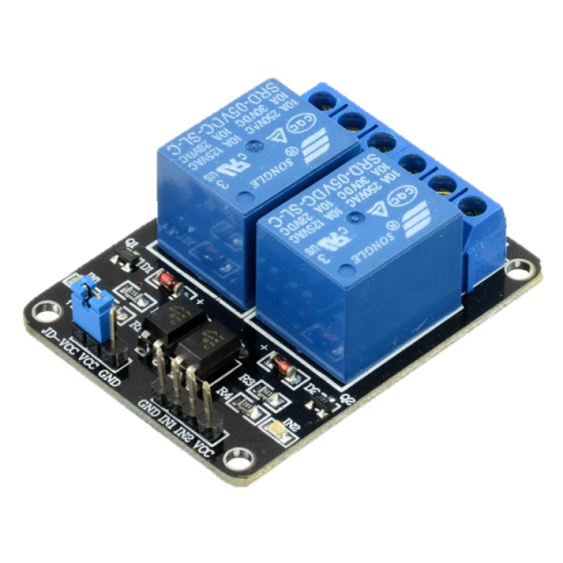

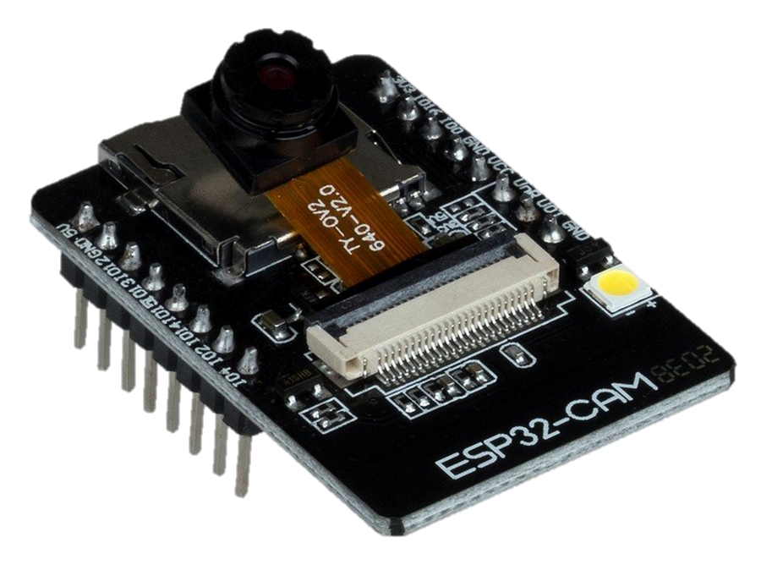
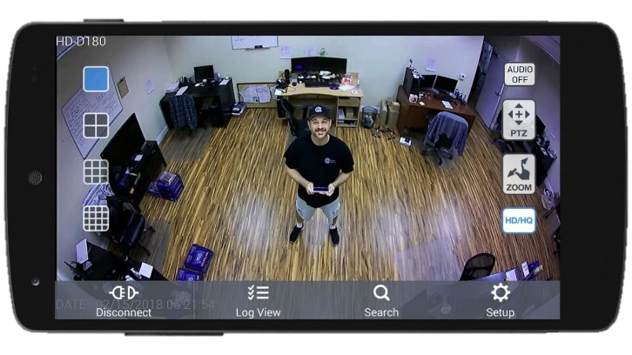
Slide 08
Programable relay module
Google Cloud
ESP32 + Cam Module
Flutter Mobile Application

Slide 9







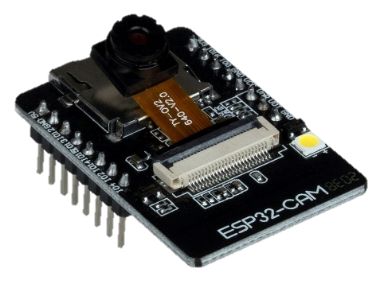
Methodology
Slide 09
Methodology
1
REQUREMENT ANALYSIS
Google form
2
DEVICE DEVELOPMENT
• ESP32 development bord,
• ESP32-CAM with OV2640 2MP camera sensor
• Clip-on antenna
• TP4056 1-cell Li-Ion Charging module
• 3D printed plastic container.
• Relay moule
3
MOBILE APP DEVELOPMENT
• Flutter
• Figma
• Firebase Authentication
• Firebase Cloud Messaging
4
Cloud DEVELOPMENT
• Google Cloud VM (Free trial):
• Yolo V8: YOLOv8,
• Python security algorithm:

Slide 10
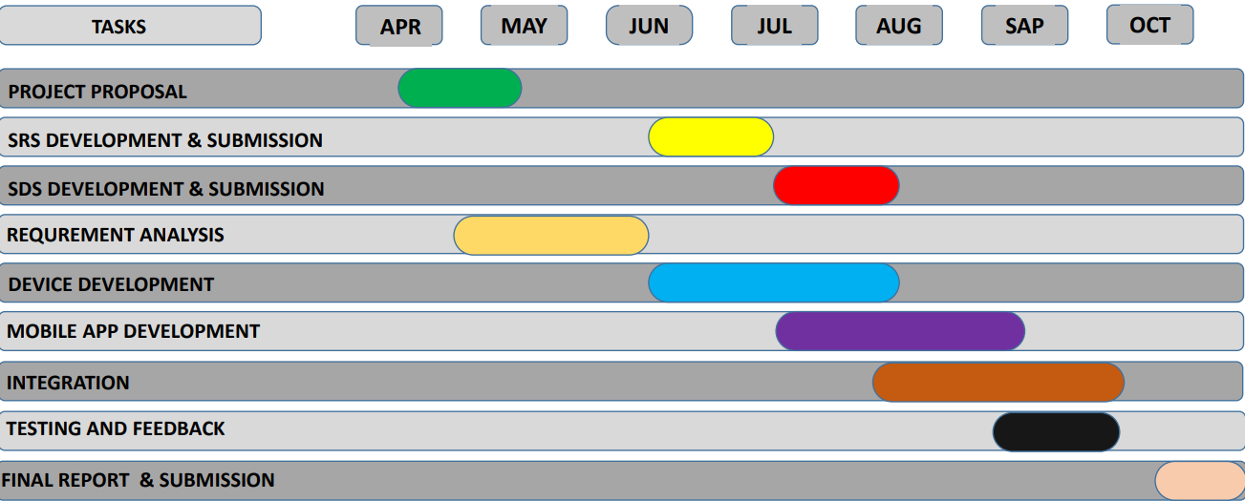
Project Work Plan
Slide 10

Slide 11

Slide 11
References
References
A.Bochkovskiy, C. Y. Wang, and H. Liao, "YOLOv4: Optimal Speed and Accuracy of Object Detection," arXiv preprint arXiv:2004.10934, 2020.
Z. Zhang, L. Xu, and S. Fu, "Edge Computing and Artificial Intelligence in Internet of Things," IEEE Communications Magazine, vol. 59, no. 2, pp. 66-72, 2021.
T. Luan, L. Gao, Z. Li, Y. Xiang, and L. Sun, "Fog Computing: Focusing on Mobile Users at the Edge," in Proc. of the IEEE International Conference on Networking, Architecture, and Storage (NAS), 2015, pp. 1- 5.
R. Gupta, A. Tewari, and A. Gaur, "Data Security and Privacy in Cloud Computing: Issues and Current Solutions," International Journal of Advanced Research in Computer Science, vol. 9, no. 1, pp. 259-266, 2018.
R. Albahar, H. T. Mouftah, and M. Erol-Kantarci, "Real-Time and Secure Video Surveillance over Cloud," IEEE Access, vol. 7, pp. 35853-35863, 2019.
X. Xing, "Flutter for Cross-Platform App Development: A Developer's Perspective," Journal of Software Engineering and Applications, vol. 13, no. 4, pp. 194-201, 2020.
J. Nielsen and R. Budiu, Mobile Usability, 1st ed. New Riders, 2013.

Slide 12
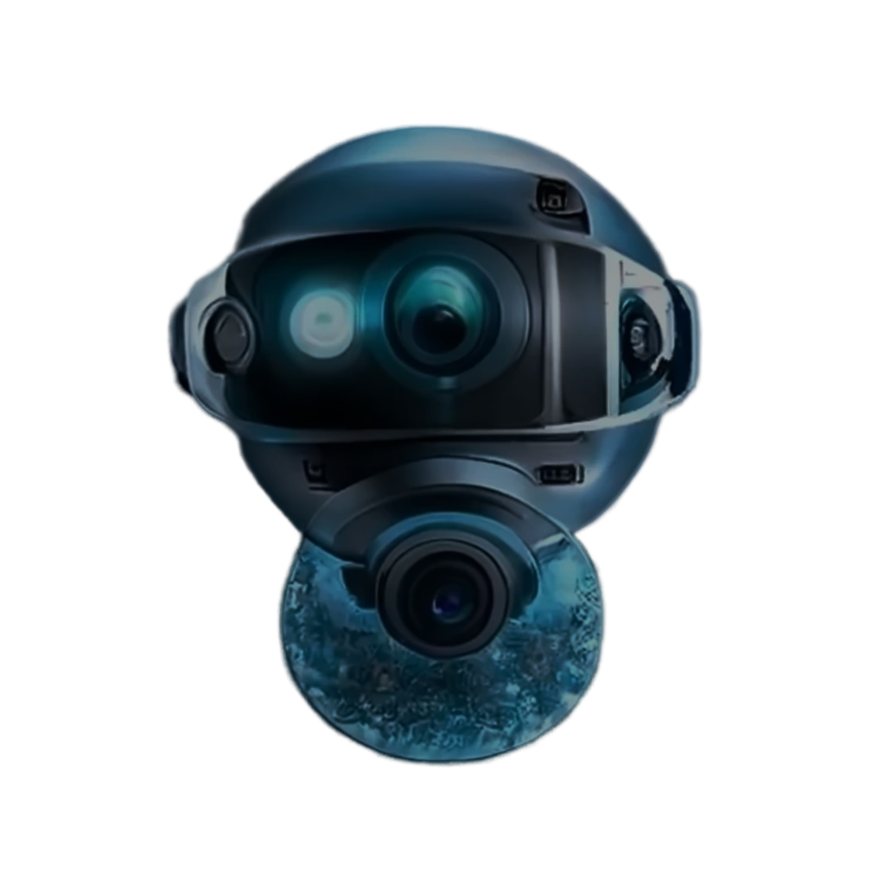

THANK YOU
Q and A?

